Slide 1
Verification of
4 term Compact Bell-Type Inequality for 8 Qubit Greenberger–Horne–Zeilinger (GHZ) State on IBM QPU
BS Project
Presenter: Shreyansh Agarwal
Roll No.: B23PH1024
Supervisor: Dr. V. Narayanan

Slide 2
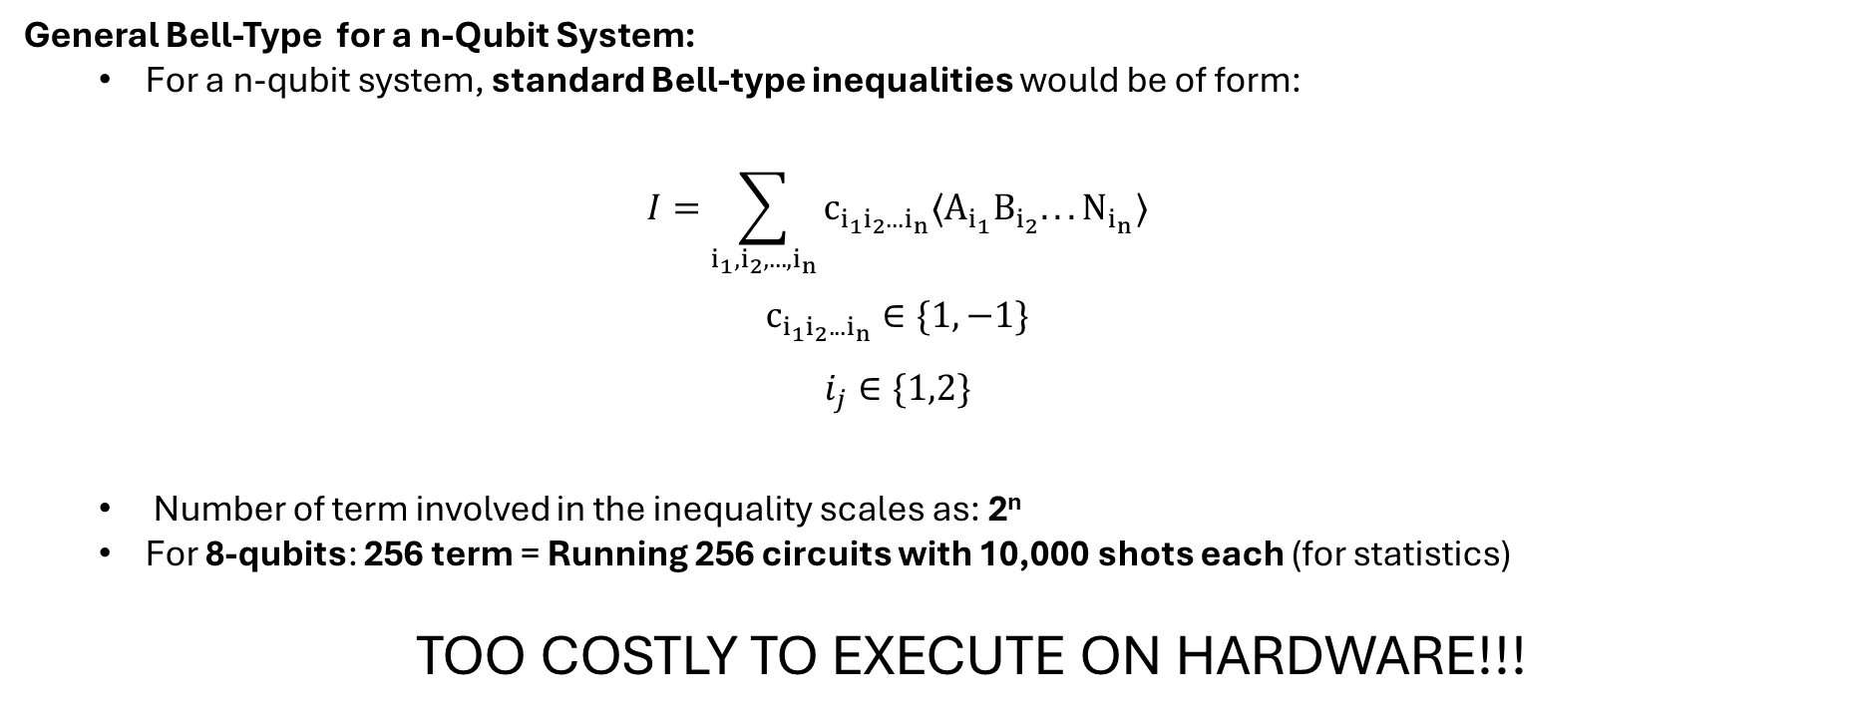
Why Compact Bell-Type Inequality?
General Bell-Type for a n-Qubit System:
  For a n-qubit system, standard Bell-type inequalities would be of form:
  $$I=\sum_{i_{1},i_{2},...,i_{n}}{c_{i_{1}i_{2}...i_{n}}〈A_{i_{1}}B_{i_{2}}...N_{i_{n}}〉}$$
  $$c_{i_{1}i_{2}...i_{n}}∈\{1,−1\}$$
  $$i_{j}∈\{1,2\}$$
  Number of term involved in the inequality scales as: 2^{n}
  For 8-qubits: 256 term = Running 256 circuits with 10,000 shots each (for statistics)
  TOO COSTLY TO EXECUTE ON HARDWARE!!!

Slide 3
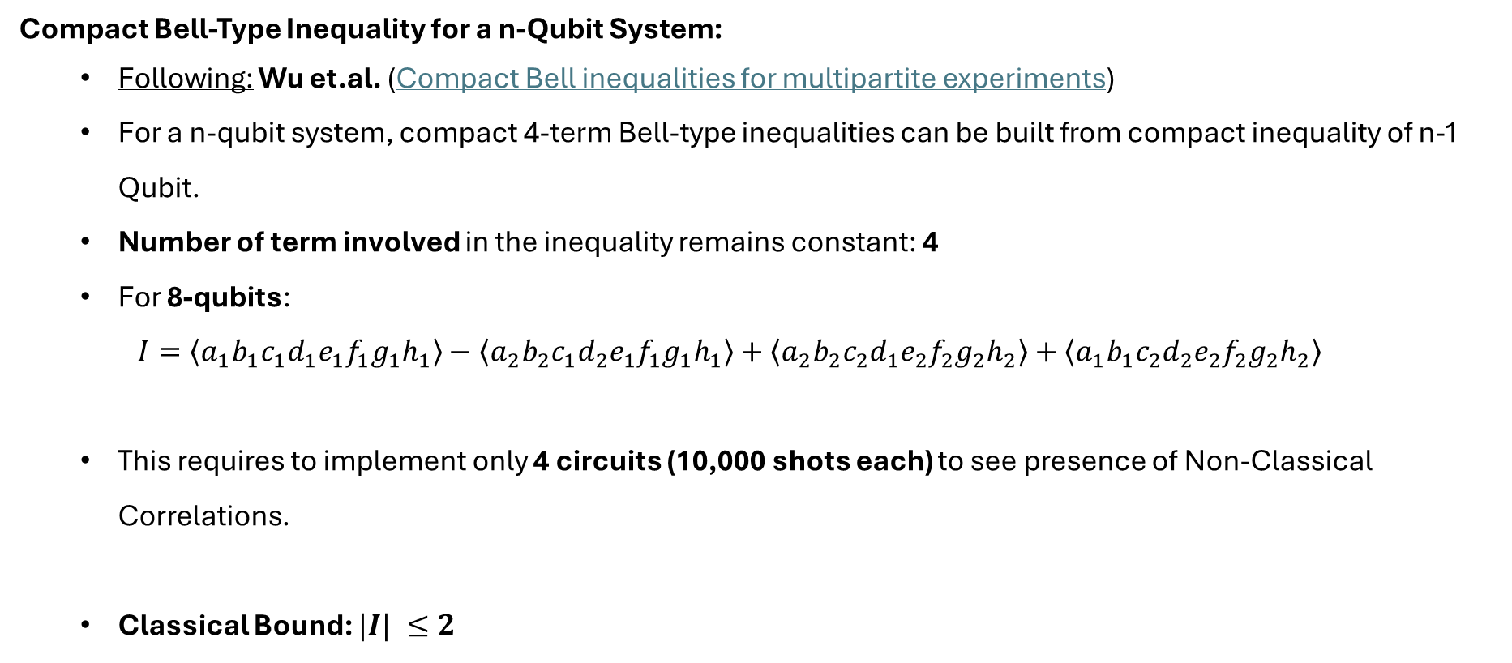
Why Compact Bell-Type Inequality?
Compact Bell-Type Inequality for a n-Qubit System:
  Following: Wu et.al. (Compact Bell inequalities for multipartite experiments)
  For a n-qubit system, compact 4-term Bell-type inequalities can be built from compact inequality of n-1 Qubit.
  Number of term involved in the inequality remains constant: 4
  For 8-qubits:
  $$I=\left\langle a_{1}b_{1}c_{1}d_{1}e_{1}f_{1}g_{1}h_{1}\right\rangle −\left\langle a_{2}b_{2}c_{1}d_{2}e_{1}f_{1}g_{1}h_{1}\right\rangle +\left\langle a_{2}b_{2}c_{2}d_{1}e_{2}f_{2}g_{2}h_{2}\right\rangle +\left\langle a_{1}b_{1}c_{2}d_{2}e_{2}f_{2}g_{2}h_{2}\right\rangle$$
  This requires to implement only 4 circuits (10,000 shots each) to see presence of Non-Classical Correlations.
  Classical Bound: $|I| ≤2$

Slide 4
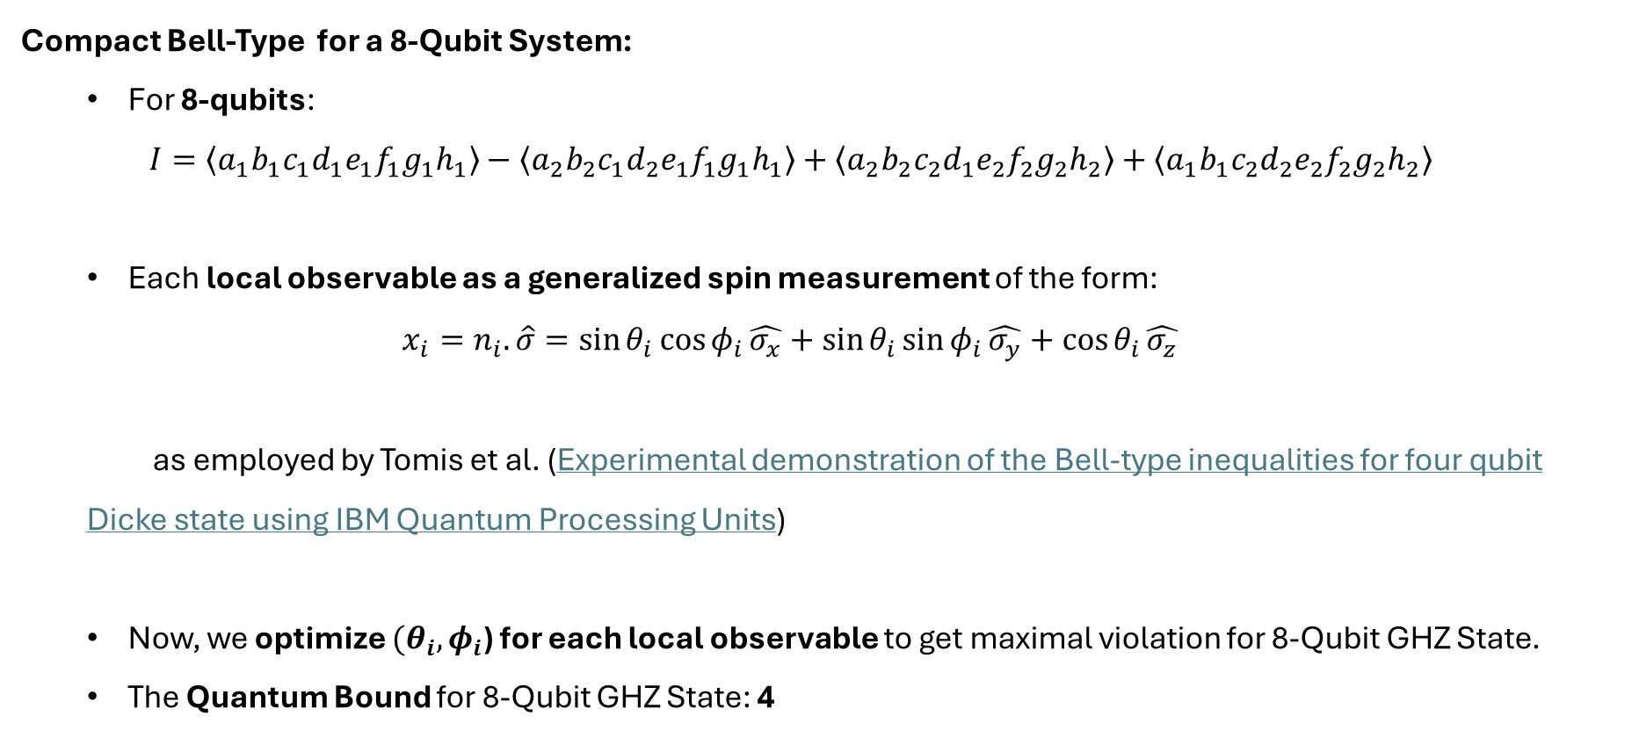
Why Compact Bell-Type Inequality?
Compact Bell-Type for a 8-Qubit System:
  For 8-qubits:
  $$I=\left\langle a_{1}b_{1}c_{1}d_{1}e_{1}f_{1}g_{1}h_{1}\right\rangle −\left\langle a_{2}b_{2}c_{1}d_{2}e_{1}f_{1}g_{1}h_{1}\right\rangle +\left\langle a_{2}b_{2}c_{2}d_{1}e_{2}f_{2}g_{2}h_{2}\right\rangle +\left\langle a_{1}b_{1}c_{2}d_{2}e_{2}f_{2}g_{2}h_{2}\right\rangle$$
  Each local observable as a generalized spin measurement of the form:
  $$x_{i}=n_{i}.\hat{σ}=\sin{θ_{i}}\cos{φ_{i}}\hat{σ_{x}}+\sin{θ_{i}}\sin{φ_{i}}\hat{σ_{y}}+\cos{θ_{i}}\hat{σ_{z}}$$
  as employed by Tomis et al. (Experimental demonstration of the Bell-type inequalities for four qubit Dicke state using IBM Quantum Processing Units)
  Now, we optimize ${(θ}_{i},φ_{i}$) for each local observable to get maximal violation for 8-Qubit GHZ State.
  The Quantum Bound for 8-Qubit GHZ State: 4

Slide 5
Label | θ (theta) | φ (phi)
a1 | 1.5708 | 0.396978
b1 | 1.5708 | 0.396531
c1 | 1.5708 | 1.00564
d1 | 1.5708 | 0.460767
e1 | 1.5708 | 1.00519
f1 | 1.5708 | 1.00564
g1 | 1.5708 | 1.00616
h1 | 1.5708 | 1.00628
a2 | 1.5708 | 1.18217
b2 | 1.5708 | 1.18214
c2 | 1.5708 | 0.691424
d2 | 1.5708 | 2.03156
e2 | 1.5708 | 0.691841
f2 | 1.5708 | 0.691328
g2 | 1.5708 | 0.691696
h2 | 1.5708 | 0.691826

Slide 6
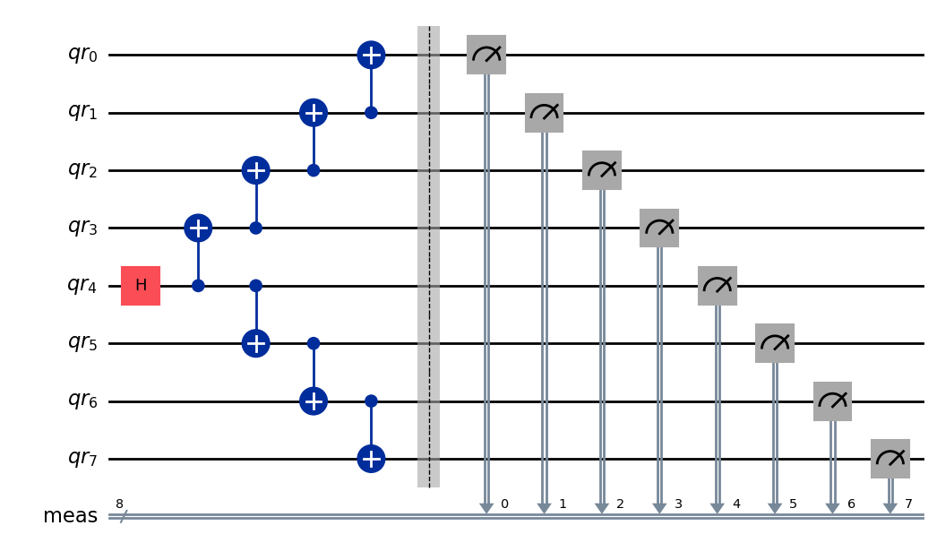
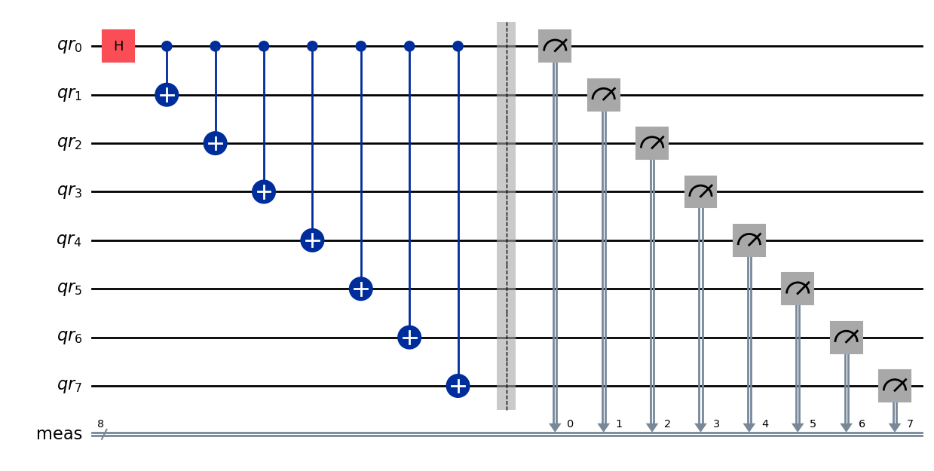
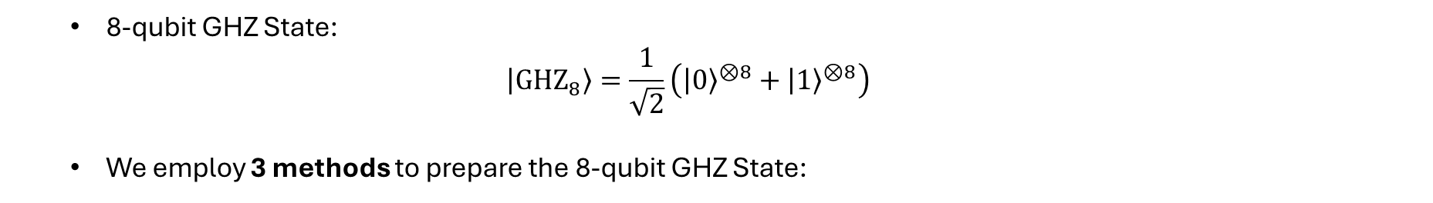
8-Qubit GHZ State Preparation
  8-qubit GHZ State:
  $$\left|{GHZ}_{8}\right\rangle =\frac{1}{\sqrt{2}}\left({\left|0\right\rangle }^{⊗8}+{\left|1\right\rangle }^{⊗8}\right)$$
  We employ 3 methods to prepare the 8-qubit GHZ State:
  1. Unitary Gate Based: Chain Topology
  2. Unitary Gate Based: Star Topology

Slide 7
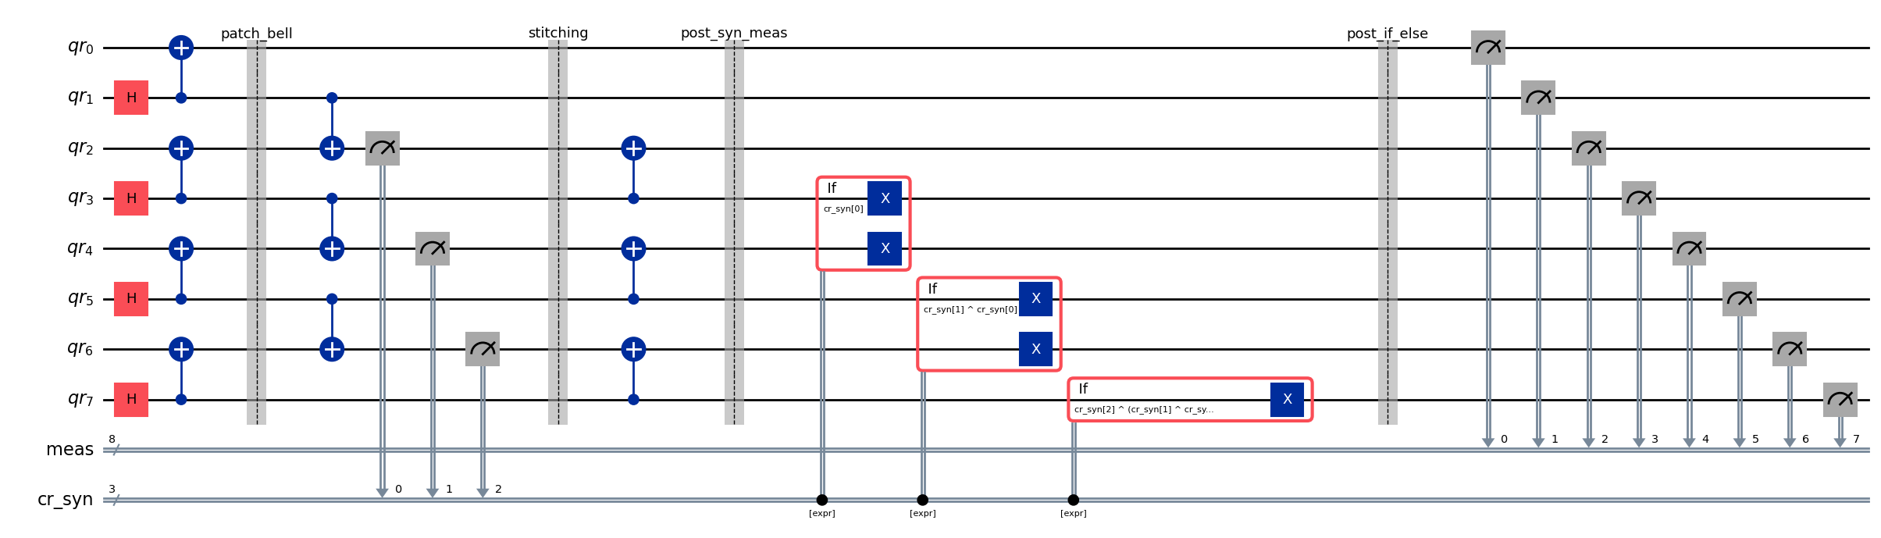
  3. Dynamic Circuits

Slide 8
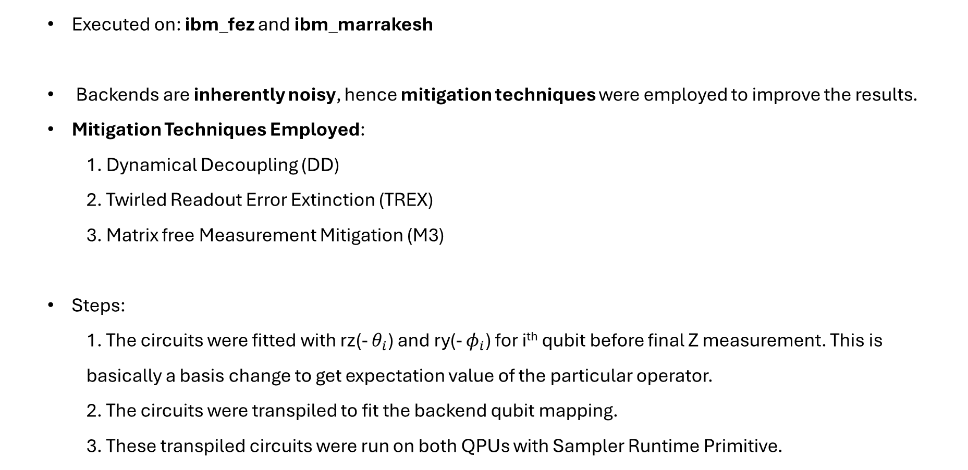
Running on IBM QPU
  Executed on: ibm_fez and ibm_marrakesh
  Backends are inherently noisy, hence mitigation techniques were employed to improve the results.
  Mitigation Techniques Employed:
  1. Dynamical Decoupling (DD)
  2. Twirled Readout Error Extinction (TREX)
  3. Matrix free Measurement Mitigation (M3)
  Steps:
  1. The circuits were fitted with rz(- $θ_{i}$) and ry(- $φ_{i}$) for i^{th} qubit before final Z measurement. This is basically a basis change to get expectation value of the particular operator.
  2. The circuits were transpiled to fit the backend qubit mapping.
  3. These transpiled circuits were run on both QPUs with Sampler Runtime Primitive.

Slide 9
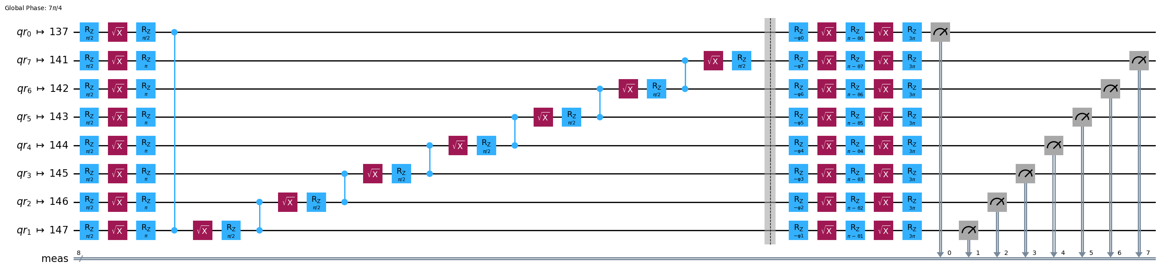
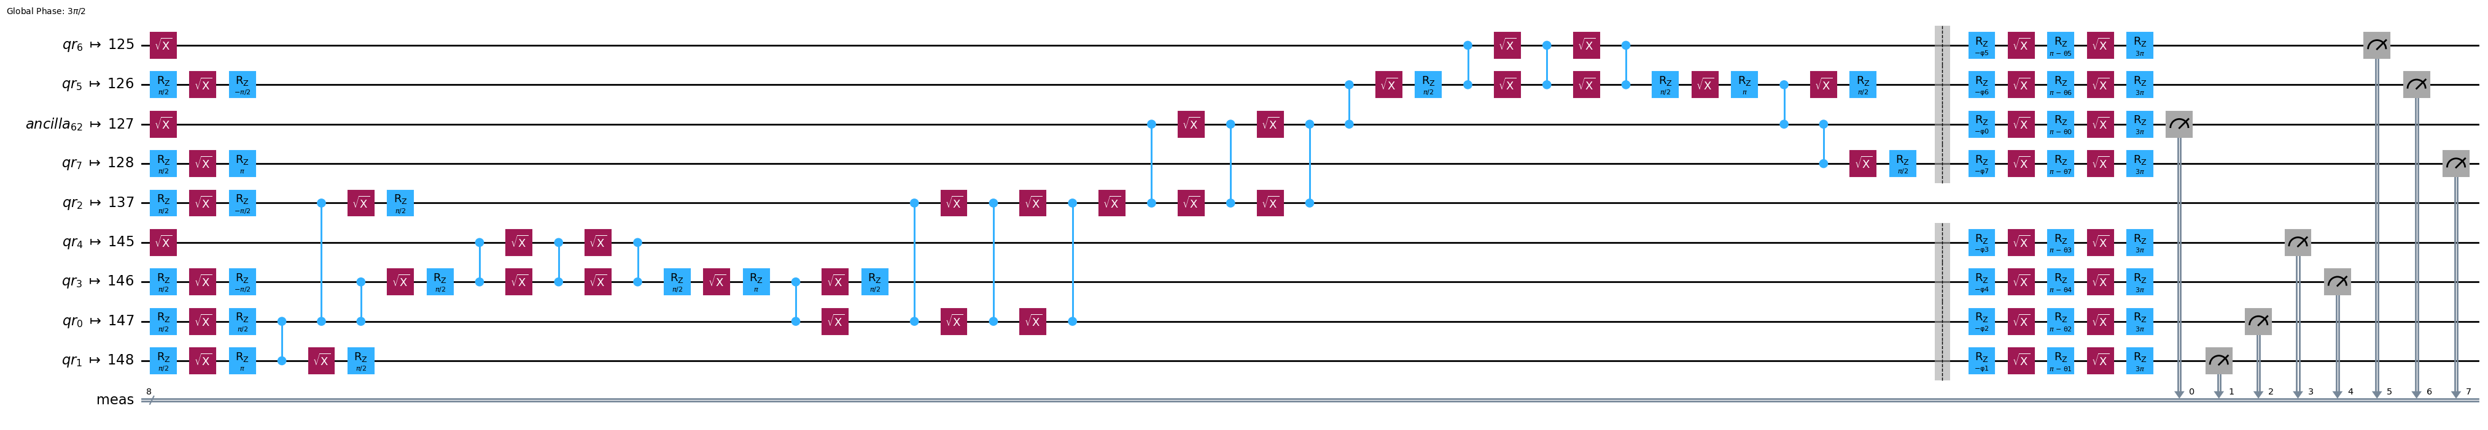
  1. Unitary Gate Based: Chain Topology
  2. Unitary Gate Based: Star Topology

Slide 10
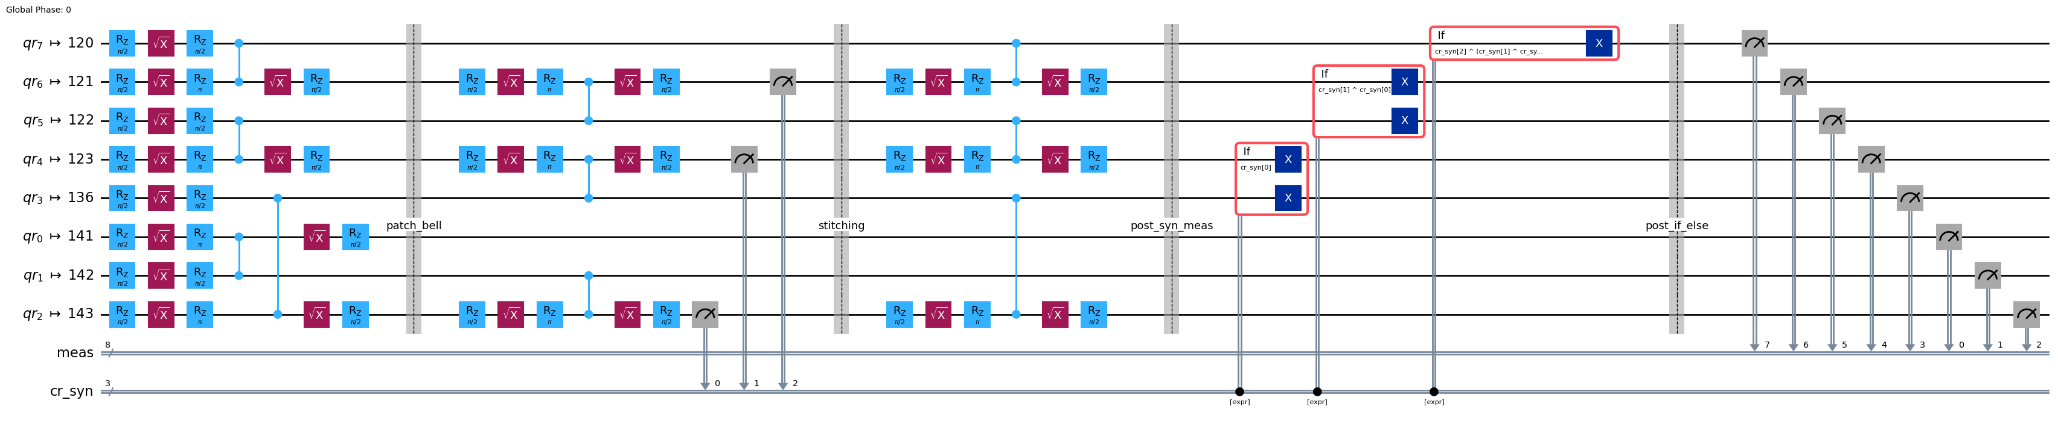
  3. Dynamic Circuits

Slide 11
Challenge
  With Dynamic Circuits we cannot apply Dynamical Decoupling normally as we did for other circuits and this cannot be achieved even by Padding Dynamical Decoupling with in-built Pass Managers.
  Reason: Circuits need to be scheduled to apply DD. But there is no way to schedule the if_else operations required for Dynamic Circuits as they are classical decision-making steps and may have some variable time depending on the classical hardware.
  So we padd DD using Stretches (a new feature introduced to qiskit).
  Stretches help us set variable delay time whose values are automatically set during the execution of circuit.
  Another Challenge: With stretches present in circuit, one cannot normally apply Twirling as it tries to twirl these stretches.
  To mitigate Dynamic Circuits we had to apply both DD and TREX manually using Stretches and Samplomatic (new features introduced to qiskit featured in Qiskit Developer Conference, 2025).

Slide 12
DD and Twirling for Dynamic Circuits

Slide 13
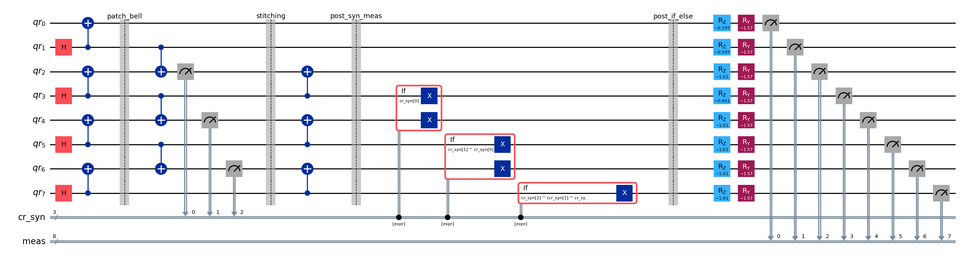
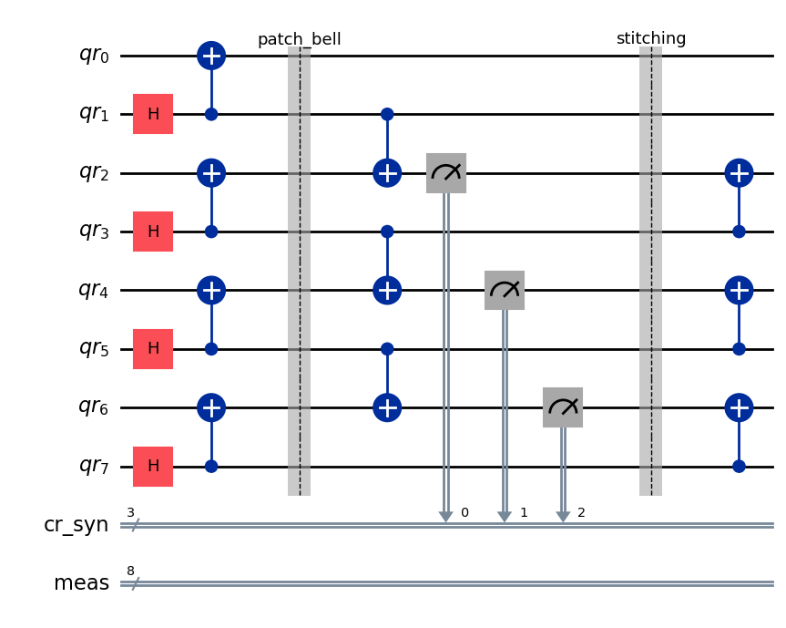
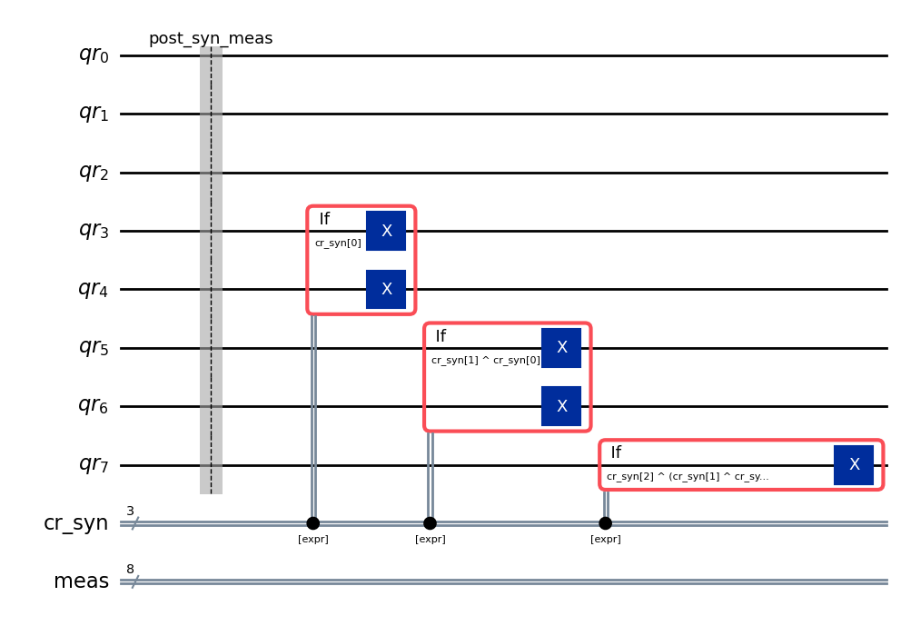
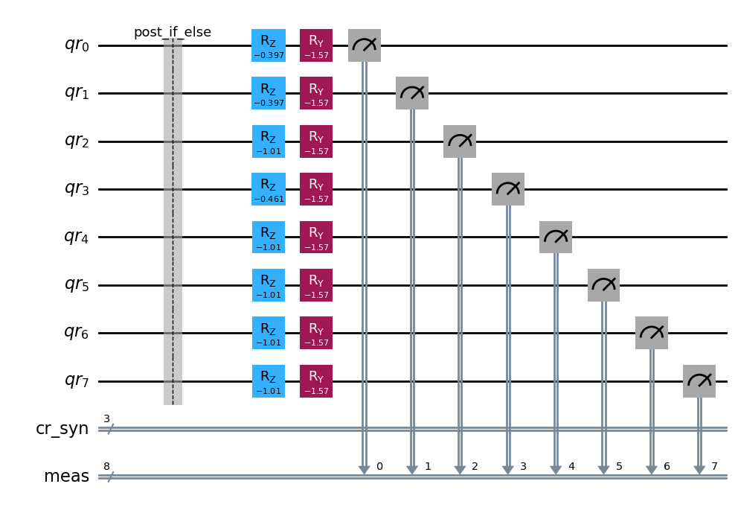
1. Split QC
Original Circuit
Circuit: Before_ifelseop
Circuit: Ifelseop
Circuit: After_ifelseop

Slide 14
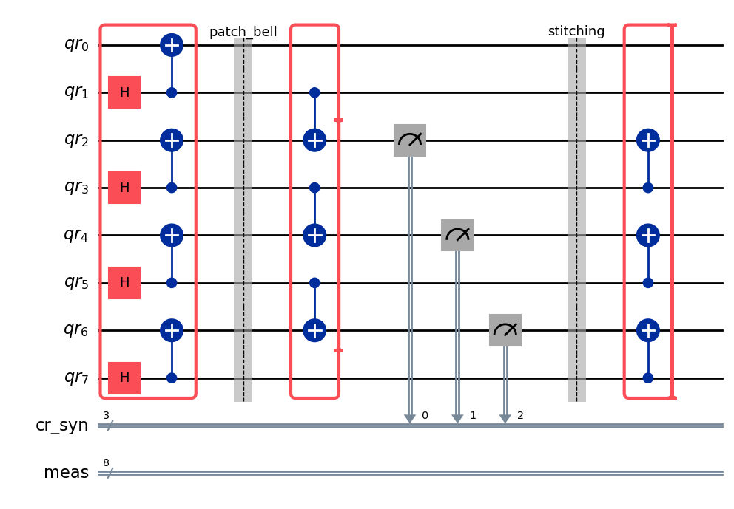
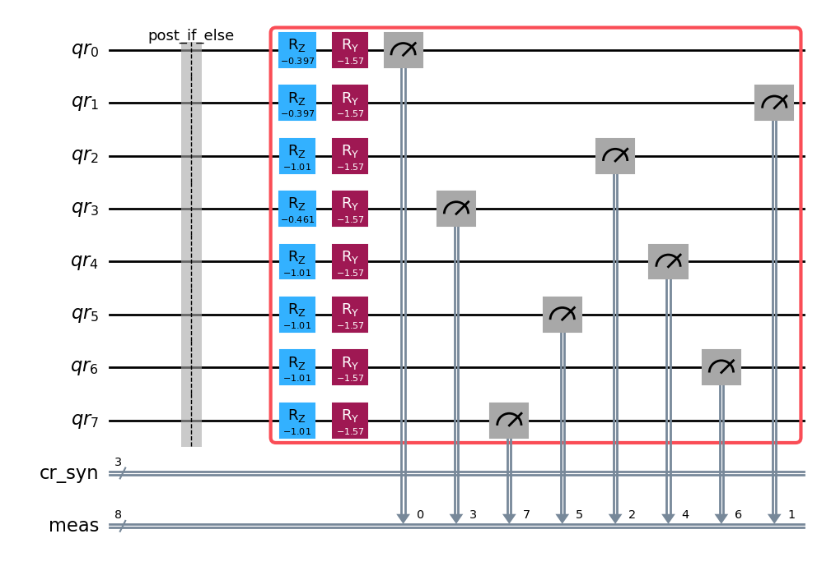
2. Apply Box for Samplomatic to Before_ifelseop and After_ifelseop
Circuit: After_ifelseop
Circuit: Before_ifelseop
Note: Don’t apply twirling box to mid circuit measurement as we will not be able to correct for Pauli Twirling before further processing and we will not get correct results.

Slide 15
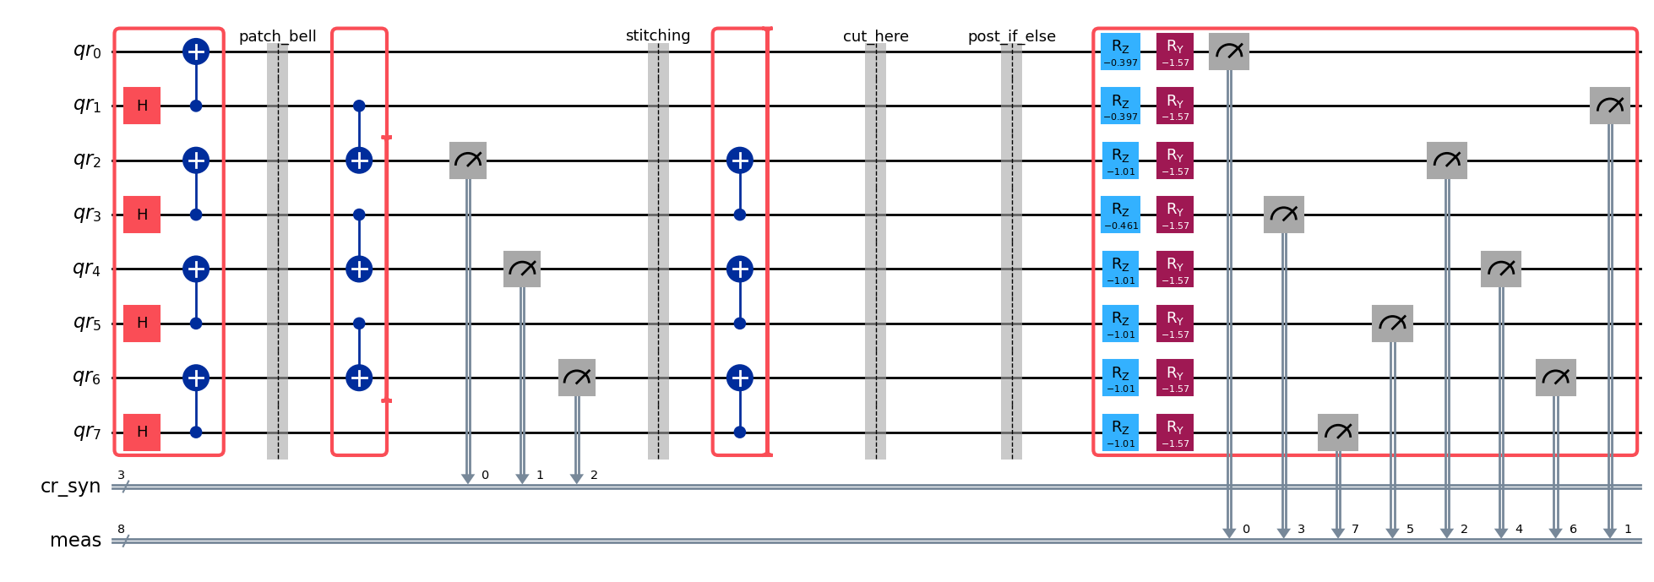
3. Combine Before_ifelseop and After_ifelseop with a barrier to label dissection point
Circuit: Before_ifelseop
Circuit: After_ifelseop

Slide 16
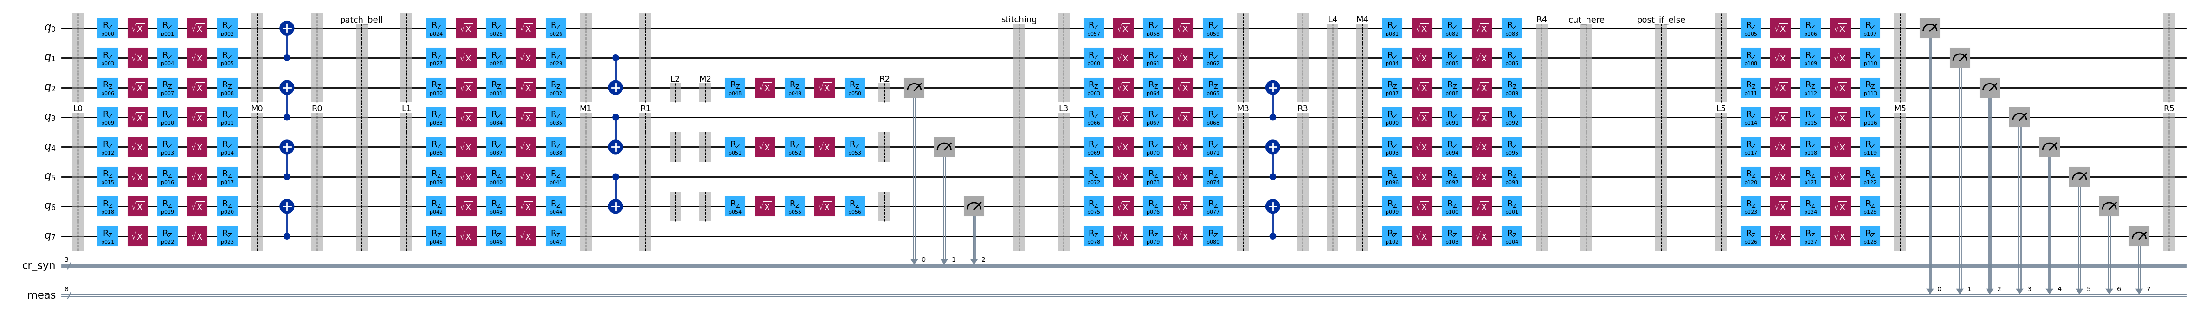
4. Construct Template and Samplex from the combined circuit and their randomizations for Twirling
Circuit: Template

Slide 17
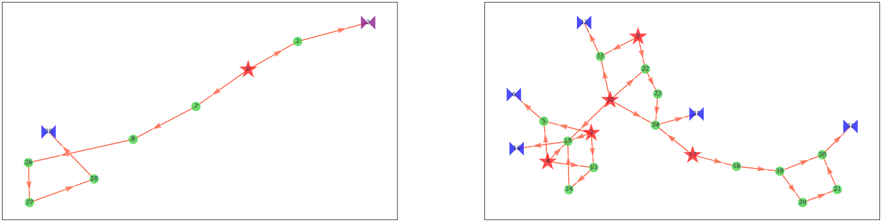
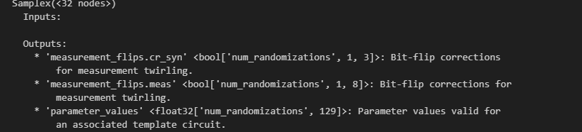
Samplex

Slide 18
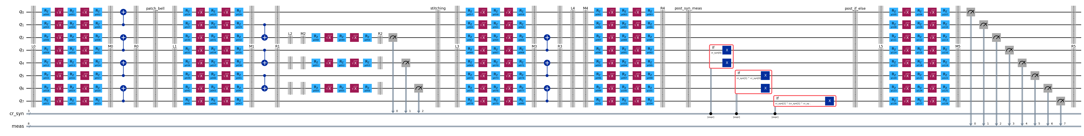
5. Cut Template from the dissection barrier and add Ifelseop circuit

Slide 19
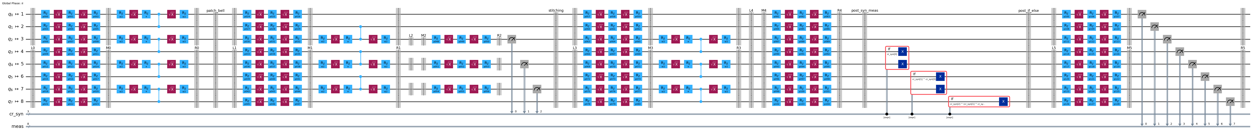
6. Transpile Template for backend

Slide 20
7. Add dd pulses using stretches to idle qubits in the Ifelseop part

Slide 21
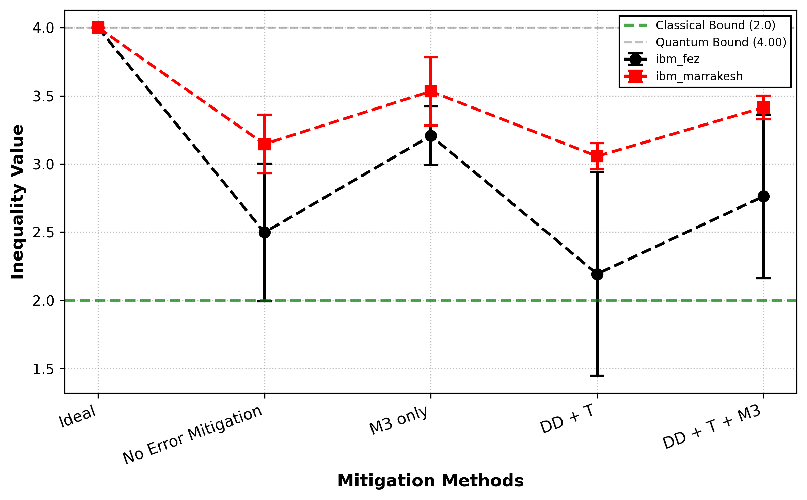
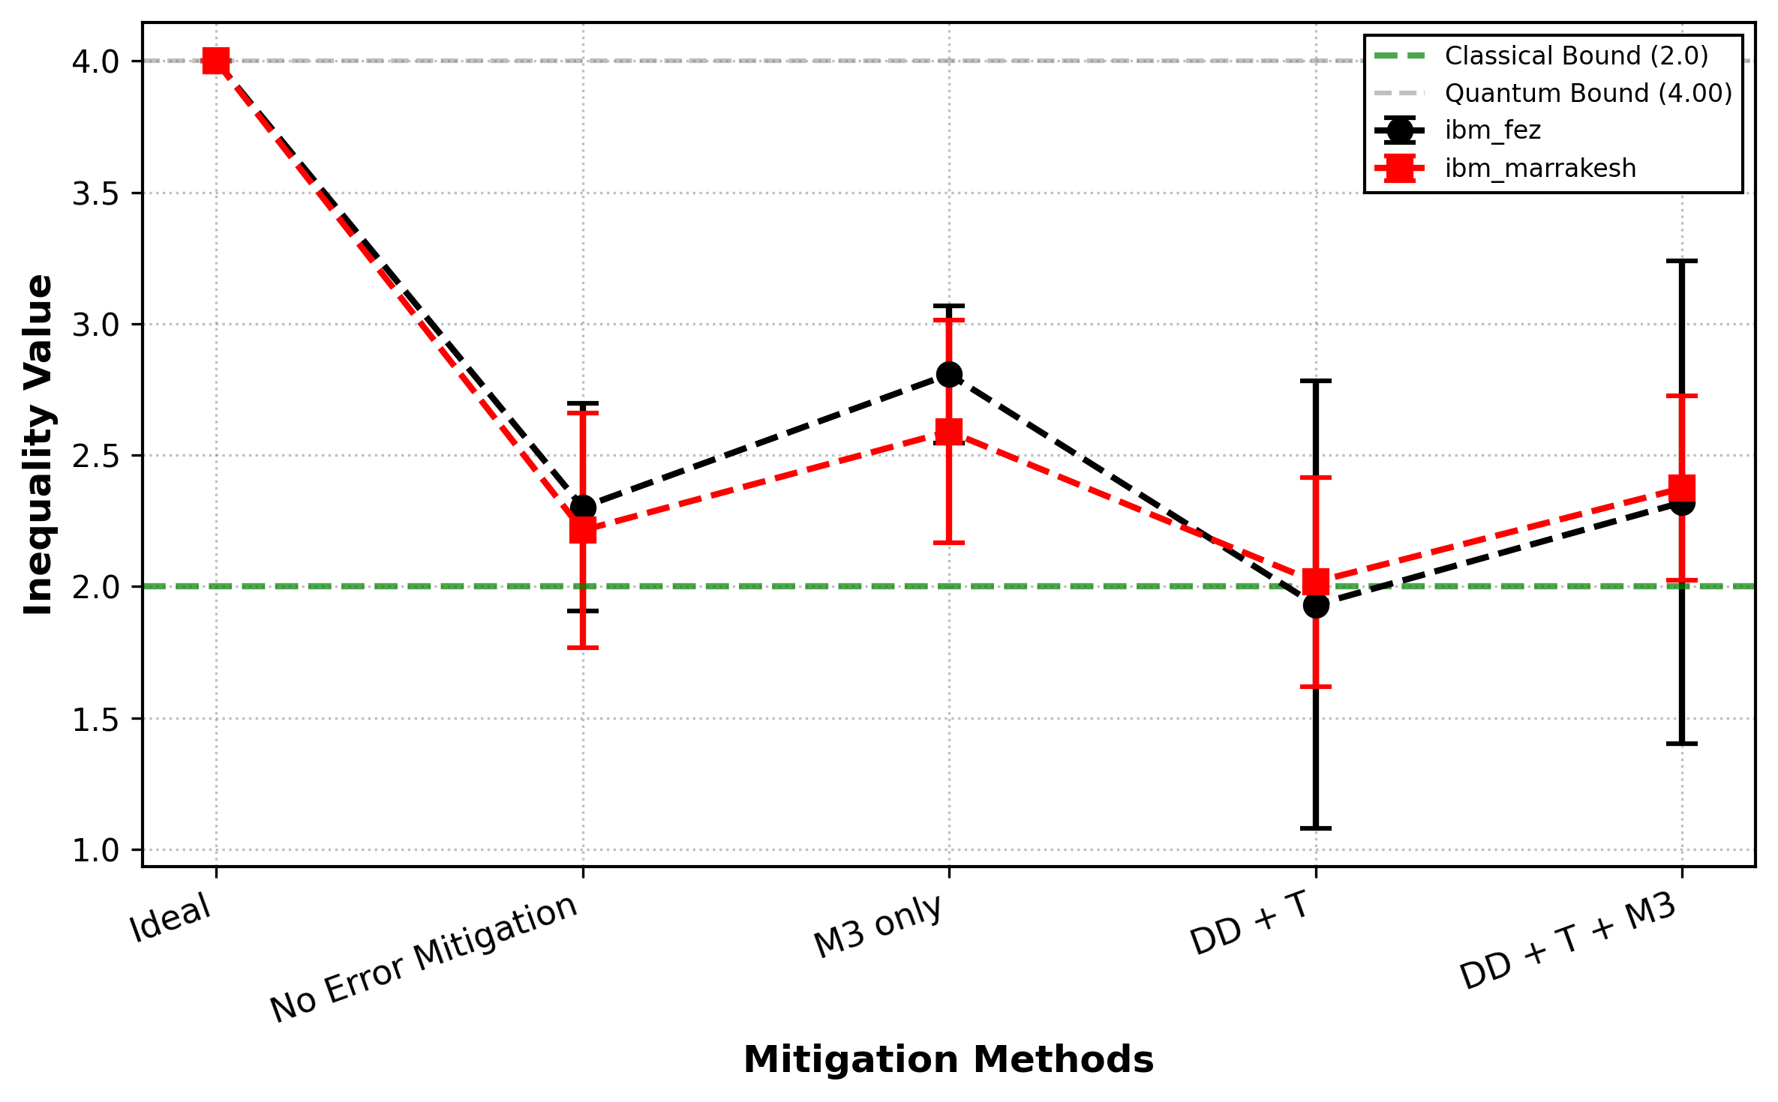
Results
  2. Unitary Gate Based: Star Topology
  1. Unitary Gate Based: Chain Topology

Slide 22
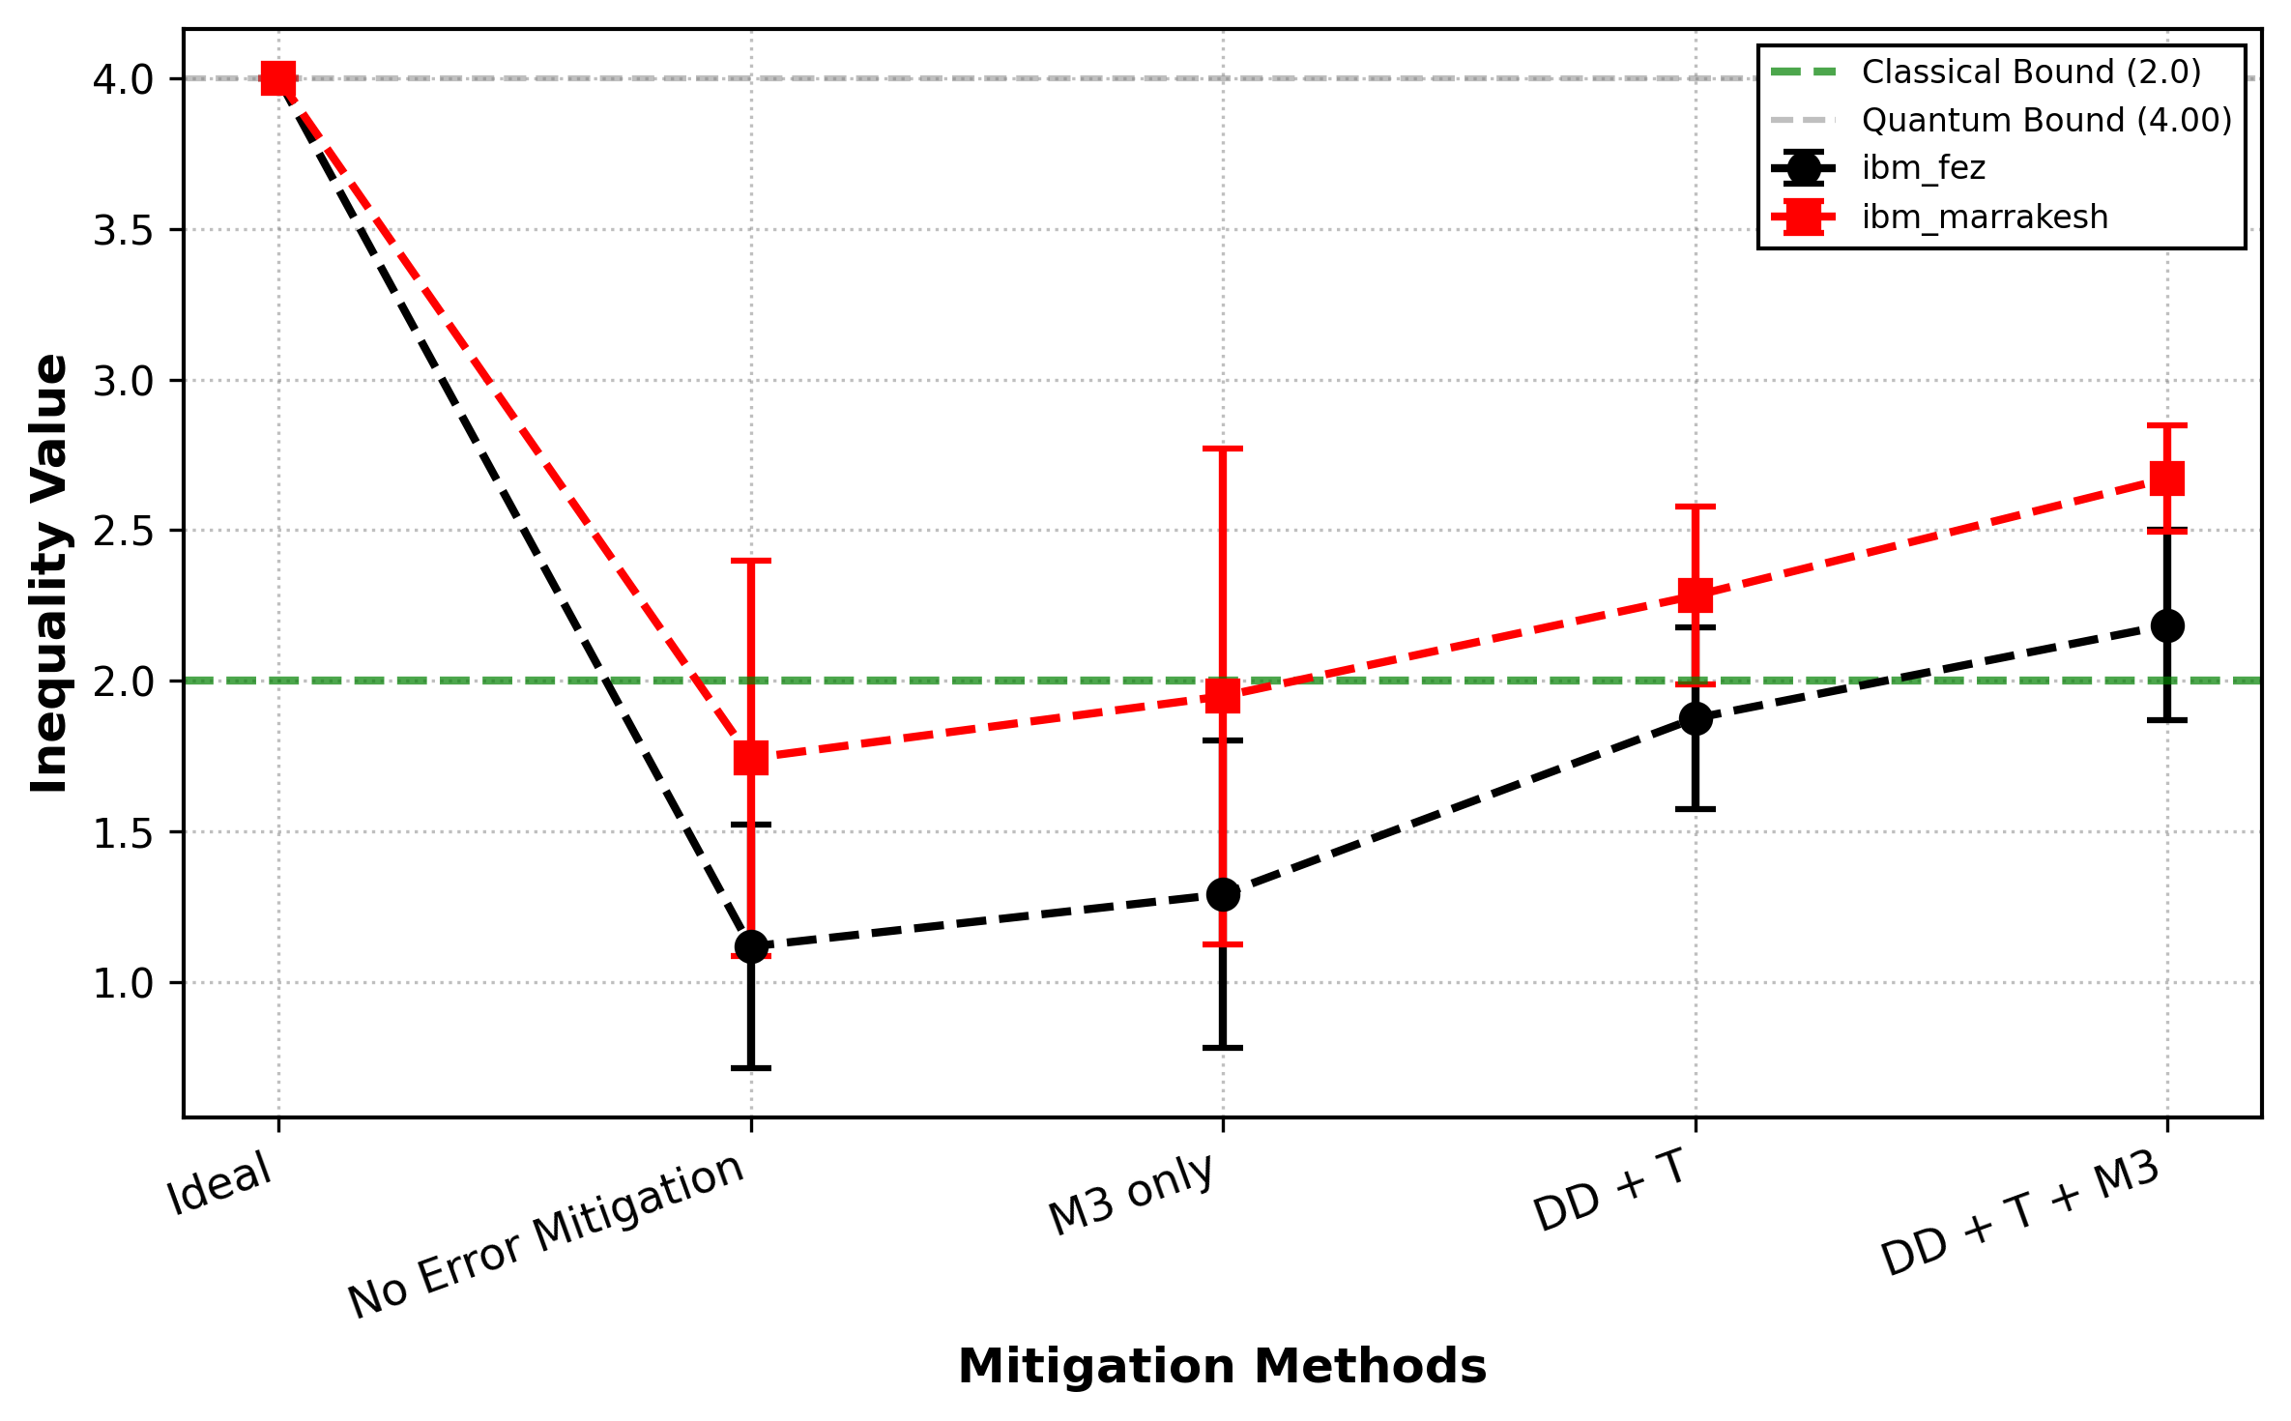
Results
  3. Dynamic Circuit

